Slide 1

Introduction to Cryptography
Encryption, Hashing, Addresses, Keys, Consensus
SoftUni Team
Technical Trainers
Software University
http://softuni.bg

Slide 2

Table of Contents
Administrative Stuff, Questions & Homework
Caesar’s cipher
Encryption and types of encryption
Addresses, keys, seeds
Hashing
Cryptography-based consensus
Homework
Sources and Further Reading

Slide 3
Questions
sli.do #B-Chain-Intro
https://www.facebook.com/groups/SoftUniIntroToBlockchainTechnologyOctober2018/

Slide 4
Administrative Stuff
Multiple Choice Tests after Every Lecture
Available Online
To be submitted by the beginning of the next lecture
Final Exam:
Available Online
Multiple-Choice Test
October 28, 2018
Notes:
Word emphasis

Slide 5
Questions: Bitcoin & IOTA Protocols
Bitcoin:
Block Size: 1 MB
Time per Block: ~10 min
Transaction per Second: ~7 transactions
Transactions per Block: ~2500-3000
IOTA:
Block Size: N/A
Time per Block: ~1 min
Transaction per Second: ~500-700 transactions
Transactions per Block: ~3
Notes:
https://medium.com/@kaykurokawa/iota-doesnt-scale-fff54f56e975

Slide 6
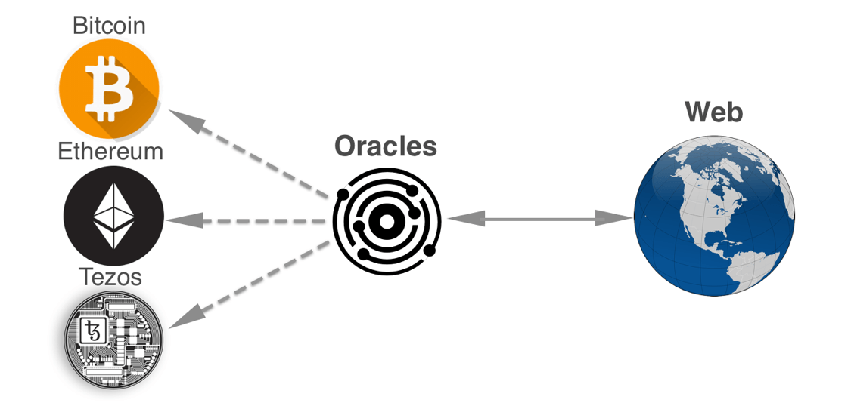
Questions: Oracles
Oracles provide data to/from the smart contract in a secure and trusted manner
Specific functionality of the smart contract is automatically executed based on an event caused by that data
Notes:
Word emphasis

Slide 7
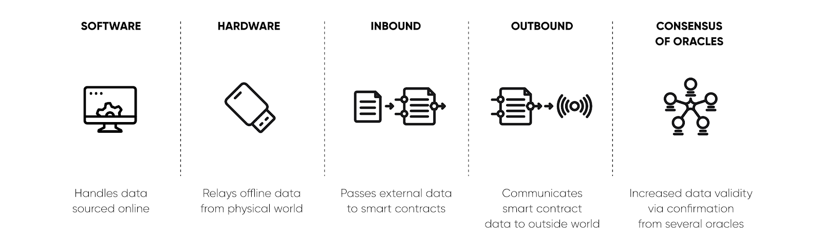
Questions: Oracles
What is a Blockchain Oracle?
Notes:
Word emphasis

Slide 8
Questions: Oracles
Example:
A smart contract that automatically buys and sells cryptocurrencies based on their exchange rate
The BTC/USD exchange rate is provided by an Oracle service.
If the rate reaches a high value, the smart contract will sell BTC and buy USD and vice-versa
Notes:
Word emphasis

Slide 9
Homework Assignment
Multiple-Choice Test from Last Time
What happens with the network if access to the Internet stops?
What happens to the blockchain? Does it continue to exist?
Notes:
https://bitcoin.stackexchange.com/questions/1738/what-would-happen-if-a-portion-of-the-bitcoin-network-was-separated-from-the-res
It wouldn't be a fork as both chains would only exists as the longest chain until the network was reconnected. As soon as Armenia was reconnected to the internet every client would via block exchange determine there is a longer block and switch to that chain. The orphaned chain would simply be discarded by all clients and eventually the entire network would be "re-unified" under the single longest chain.
In a situation like that it would be difficult but not impossible to pull off a double spend. An attacker would need to have wallets in both sub-networks so coins could be spent in both sub-networks during the "isolation". A precaution to take when isolated from "main internet" is to not process any transactions until the sub-networks have rejoined.
For example a store could accept coins, and prepare orders but not ship them until rejoining the main network and ensuring no double-spend occurred. If a double-spend had occurred the merchant would become aware once the larger network began processing the orphaned transactions and they were reported as invalid by the network. If no double spend occurred those transactions would eventually be included in longest blockchain and become confirmed.
For those in the "main network" there is no risk from a double spend because their chain will remain longest and will survive while overwriting transactions from the smaller sub-network once the networks are rejoined.

Slide 10
Questions
Questions?

Slide 11
Why Cryptography - History
The earliest types of encryption
Shift (substitution) cipher
Permutation cipher
A fundamental part of Computer Science
A science that ensures information security
Statistical breakdown of occurrences
Notes:
Word emphasis

Slide 12
Why Cryptography (2)
Random numbers / cryptographically secure random numbers
Computationally secure
If the best possible algorithm for breaking it requires N operations where N is such a large number that it is infeasible to carry out this many operations.
Unconditionally secure
It cannot be broken even with infinite computing power.

Slide 13
Cryptography and Blockchain
One of the building blocks of any proper blockchain
Integrity and truthfulness of the ledger
Transaction authenticity
Transaction privacy
Node identity

Slide 14
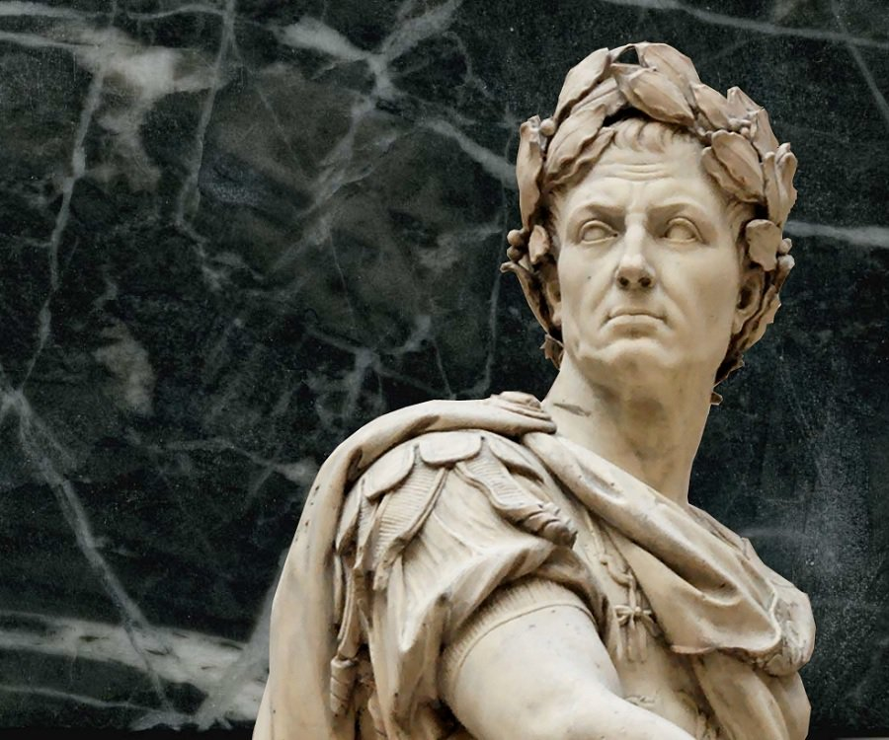
Caesar's Cipher
The pioneer in encryption

Slide 15
Caesar's Cipher (Shift Cipher)
Called also shift cipher when key ≠ 3
Transforming plain text into cipher text under the control of a secret key.
Each letter from the alphabet is substituted with another according to:
Fixed length
Left
Right shift

Slide 16
Ceasar’s Cipher (2)
Left shift of three
E -> B
eorfnfkdlq -> blockchain
A malicious party could
attempt to brute-force the key
A
B
C
D
E
F
A
B
C
D
E
F

Slide 17
Caesar's Cipher (3)
Fixed length and shift direction are the key to decryption
Each party needs access to the secret key. This needs to be known to both sides, but needs to be kept secret.
Encryption algorithms with this property are called symmetric cryptosystems or secret key cryptosystems.

Slide 18

Encryption
Symmetric and Asymmetric Encryption

Slide 19
Symmetric Encryption - Description
Ceasar’s cipher is a type of symmetric encryption
It involves a secret key
A number, or word
Apply it to plain text – it changes in a specific way
Symmetric -> both sender and receiver use the same key
Possibly use different decryption key

Slide 20

Symmetric Encryption – Pros and Cons
There is a pronounced need to change keys frequently
per message or
per session
Frequently changing keys results in difficult key management and distribution techniques
Solution:
public key (key-pair)cryptography.

Slide 21
Asymmetric Encryption - Description
Public key cryptography
Originally invented to solve the key distribution problem
Many advantages over symmetry-based systems
Parties do not need to know each other
One public and one private key
They replace the use of one key by two parties
Message + Alice’s public key (K_{pub}) = Ciphertext,
Ciphertext + Alice’s private key (K_{priv}) = Message.

Slide 22
Asymmetric Encryption – Pros and Cons
The two keys are related in such a way that:
knowing the public key tells you nothing about the private key
knowing the private key allows you to unlock information encrypted with the public key.
Computationally infeasible to derive (K_{priv}) from (K_{pub})
If Alice can decrypt a message with Bob's public key she knows that the message must have come from Bob because no one else has Bob's private key.

Slide 23

Address, Key, Seed

Slide 24
Bitcoin Address
Communications and transactions are not actually encrypted
Bitcoin cryptography governs the ownership of funds, in the form of keys, addresses and wallets.
Bitcoin public address:
Public key
Your identification on the network
Think IBAN (public key) and PIN (private key) to account

Slide 25
Bitcoin Address (2)
Derived from a public key using a one-way function.
Double-hashed
Then run through Base58Encoding function
0 (zero), O (capital o), l (lower L), I (capital i), “+” and “/” are omitted.
Recipient or sender of funds
Always start with 1 or 3(version prefix)
1BvBMSEYstWetqTFn5Au4m4GFg7xJaNVN2 (traditional)
3J98t1WpEZ73CNmQviecrnyiWrnqRhWNLy (multi-sig, BIP16)

Slide 26
Bitcoin Key Pair
The public key is used to receive funds
The private key is used to sign transactions to spend the funds.
When spending bitcoins:
Present your public key and a signature (created for each transaction out of the private key) in a transaction to spend those bitcoins
Presenting the public key and the signature, everyone in the bitcoin network can verify and accept the transaction as valid

Slide 27
Private Key
A random number 256-bit number
64-bit in hex
10⁷⁷ in decimal
Mass of the visible universe between 10⁵⁰ and 10⁶⁰ tons
Googol number 10¹⁰⁰
Must be kept in secret

Slide 28
Public Key
Derived from private key by means of elliptic curve multiplication
From a given public key you cannot calculate the private key
Relationship is fixed and one-directional

Slide 29
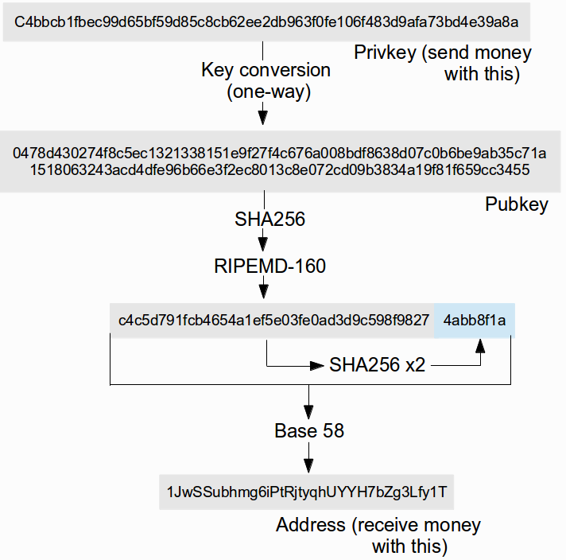
The Bitcoin Address Architecture
Notes:
Add source,

Slide 30
Digital Signatures
Each transaction associates an amount of bitcoins with a bitcoin address
The current owner’s signature verifies for everyone that the transaction is authentic
When bitcoins are sent to someone:
The transaction records the transfer of these exact bitcoins
From the current owner’s Bitcoin address
To the new owner's Bitcoin address
Includes a valid digital transaction signature
Notes:
https://blockchain.info/en/block/000000000000000000725957bfd2a881e56951df690c8d082da707d1a1e0199a

Slide 31
Digital Signatures (2)
When this transaction is broadcast to the Bitcoin network, every peer knows that the new owner of these bitcoins is the owner of the receiving Bitcoin address

Slide 32
Schema
Alice ->
signing key (private key, S_{k}) ->
verification key (V_{k})
M
S_{k}
M
S_{M}
V_{k}
S_{M}
Yes or No

Slide 33

Vanity Address
https://bitcoinvanitygen.com/

Slide 34
Vanity Address – Specification
Need to generate billions of private keys
Derive the corresponding public key
Derive the bitcoin address
Check if the address matches the desired string
Depending on desired text:
1 in about 300 million to
1 in 1 trillion
Notes:
Поръчков адрес

Slide 35

DNS on the Blockchain
Services mapping BTC address to human readable text

Slide 36
The Seed
12-word long mnemonic phrase
A list of 2048 predefined words
Combinations 2048¹²
The phrase is used to recover a key pair
Remember: random and cryptographically random
Notes:
https://www.myetherwallet.com/
https://iancoleman.io/bip39/

Slide 37

Hashing
A type of encryption

Slide 38
Cryptographic Hash Functions
Manipulation detection code
Used to guarantee integrity, rather than security
Preimage Resistant:
It should be hard to find a message with a given hash value.
Collision Resistant
It should be hard to find two messages with the same hash value.
Avalanche function
A small change in input results in unpredictable change in output

Slide 39
Cryptographic Hash Functions (2)
A type of encryption
One-way function
Input: random string
Output: fixed-size string
Widely used
https://www.fileformat.info/tool/hash.htm
http://passwordsgenerator.net/sha256-hash-generator/
Many different functions

Slide 40
Hashing
Verify block integrity
Establish the chronological order of the blockchain
“Double-hashing”

Slide 41

Cryptography-Based Consensus

Slide 42
Consensus
Consider getting paid
An amount the parties have agreed to
In currency that is recognized as a medium of exchange
This currency is scarce
A suitable form of payment
Therefore, bananas seldom work

Slide 43
Consensus (2)
(Digital banking)
Consensus rest with the Central Bank
Ensure the way money are sent/received
In charge of new money
Everyone chooses to trust it

Slide 44
Consensus on the Blockchain
A protocol guarantees
The ways to obtain the monetary unit
The act of transfer
The scarcity of supply
By
ensuring that the next block in a blockchain is the one and only version of the truth
keeping powerful adversaries from derailing the system and successfully forking the chain

Slide 45
Consensus on the Blockchain (2)
Trustless by definition
Compare to central banking server
Cannot trust one single entity

Slide 46
Consensus – Proof of Work
In Bitcoin, the SHA256 hashing must produce a sequence starting with 18 zeros. The number of zeros is set by the difficulty.
What are the chances to have a hash starting with 0?
2^{n}- for every subsequent zero
Mining is the process of generating the proof-of-work
Lasting consensus, over the whole ledger

Slide 47
Consensus – Proof of Work (2)
The following steps are executed in a loop so that the system can reach consensus in a trustless, decentralized way:
Increment (add 1 to) an arbitrary number in the block header – the nonce
Take the hash of the resulting block header
Check if the hash of the block header, when expressed as a number, is less than a predetermined target value
Therefore, mining is measured in hashes per second

Slide 48
Consensus – Proof of Stake
A “validator” invests in the coins of the system
Validators (also called stakeholders, because they hold a stake in the system) are paid strictly in transaction fees.
Require much less computational power and potentially eliminates the 51% problem
Other issue: validators with nothing to lose can behave badly, e.g. double sign
Notes:
http://www.masternodes.pro

Slide 49

Summary
Ancient shift ciphers are the first form of cryptography
Cryptography plays a major role in cryptocurrencies
Asymmetric encryption, hashing and double hashing
ensure system integrity
Reaching consensus in an anonymous, trustless and decentralized way characterizes any proper crypto currency

Slide 50

Homework
Research and think of ways to keep your private keys safe.

Slide 51
Sources and Further Reading
Caesar's cipher
The Wiki
Caesar's cipher demo
Encode your next message to someone
Description of symmetric and asymmetric encryption
A Microsoft article
Security app for phones and computers
Can be used for daily communication

Slide 52
Sources and Further Reading (2)
Base58Check encoding
The BTC Wiki
Crypto101 – Terminology
Tutorial for crypto-newbies
Bitcoin book, chapter 4 - Keys, Addresses
A detailed walkthrough
Numbers of atoms in the universe
The type of numbers cryptographers work with

Slide 53
Sources and Further Reading (3)
Elliptc curve point multiplication
Wiki article
More on Base58
Online encoder, decoder and validator
Vanity address generator
An online service
Bitalias
Bitcoin DNS

Slide 54
Sources and Further Reading (4)
Mnemonic phrase
The BTC Wiki on the word representation of your private key
What are hash functions
Hash functions explained
Short guide - blockchain consensus protocols
Coindesk article
Nigel Smart, "Cryptography: An Introduction“
Book available online

Slide 56
SoftUni Diamond Partners

Slide 57
SoftUni Diamond Partners

Slide 58





Trainings @ Software University (SoftUni)
Software University – High-Quality Education, Profession and Job for Software Developers
softuni.bg
Software University Foundation
http://softuni.foundation/
Software University @ Facebook
facebook.com/SoftwareUniversity
Software University Forums
forum.softuni.bg

